Slide 1

Visualization of Expenditure from G-20 Countries
DATS 6401 Visualization of Complex Data
Xi Zhang
G28490493
Instructor: Nima Zahadat, Ph.D.

Slide 2
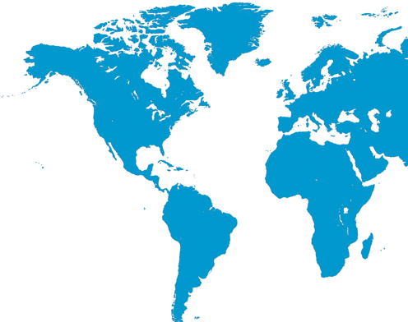
Agenda
Data Source
Data Preprocessing
Programming Introduction
Analysis by Category
Overview
Education Expenditure
Healthcare Expenditure
Military Expenditure
GDP Impact
Conclusion

Slide 3

Data Description
Data Source:
World Bank: https://data.worldbank.org/
Research Catalogs:
GDP; Population; Education; Healthcare; Military
Selected Countries:
USA, UK, France, Canada, Japan, China, India, Mexico, Australia, South Korea
Selected Years:
2010 – 2016

Slide 4

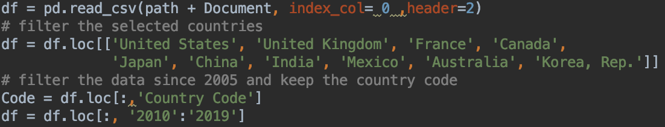
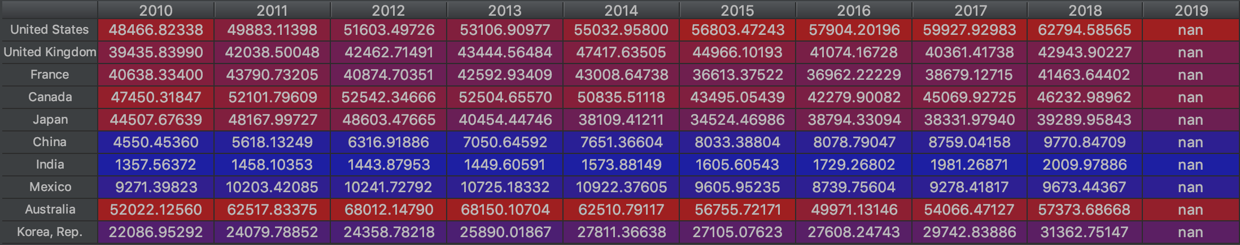
Data Preprocessing
Read data and filter the last ten years and selected countries.
Obviously, there are many missing values in 2019. Then I check the data quality.
Notes:
I did data preprocessing on python, which includes fixing the missing or duplicated value. For example there are many missing values in 2019. So I just dropped this column.

Slide 5
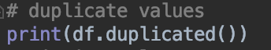
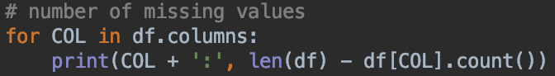
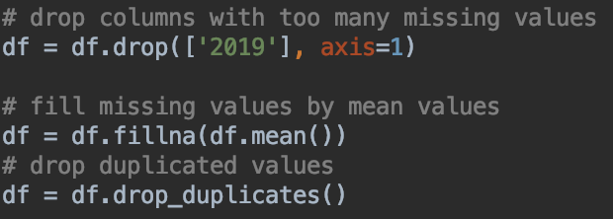
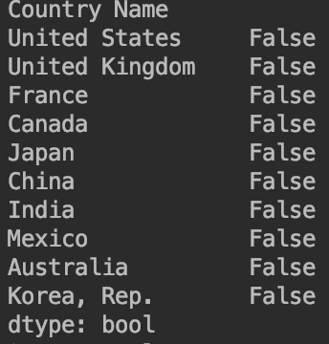
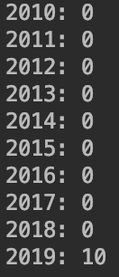
Data Preprocessing
Check the duplication, missing values and fix the problems.
After traversing all the datasets, missing values always focus on 2017 – 2019. Therefore, I only use data from 2010 -2016 for my following researches.
For other small parts of missing, I fixe them by filling by mean values.

Slide 6
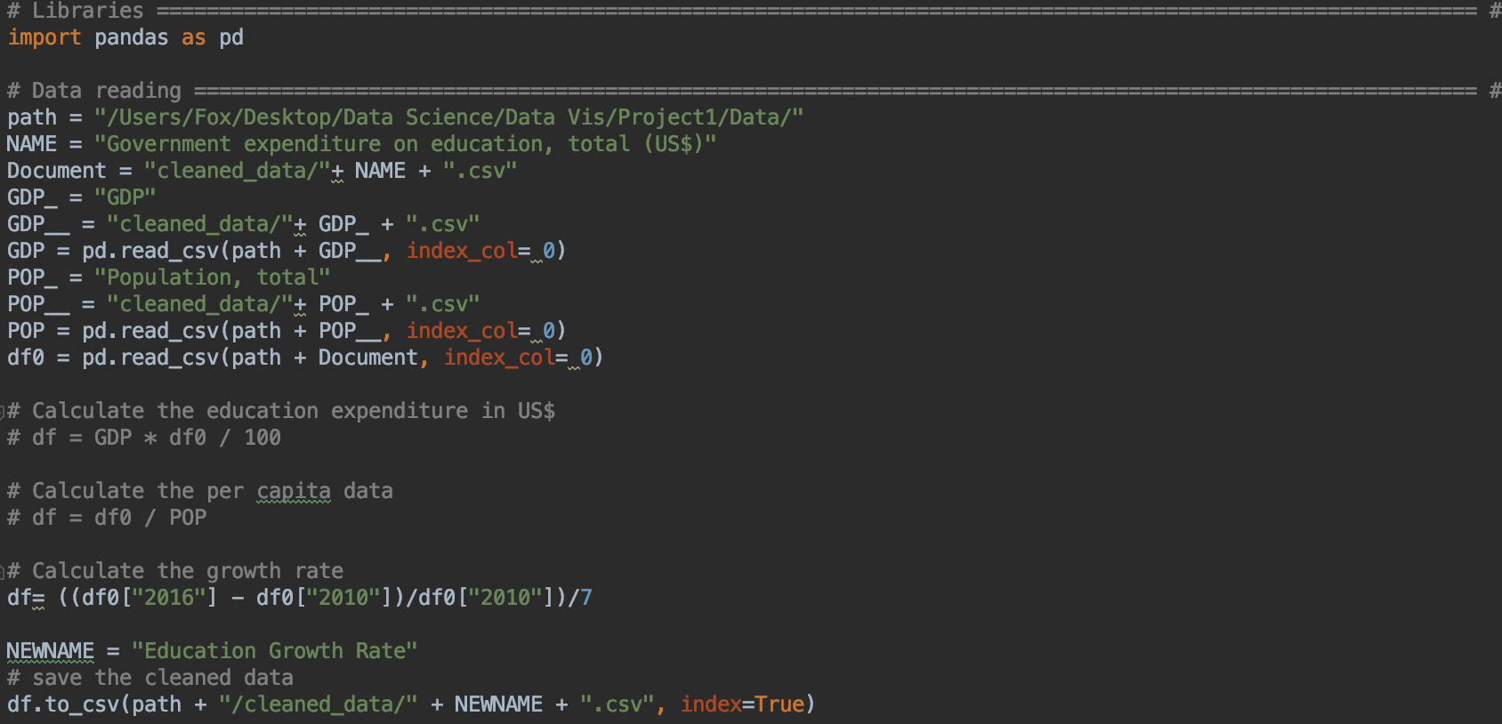
Data Preprocessing - Calculation
I load the associated data and write formulas to calculate expenditures in different units and growth rate for every categories .
Notes:
This part shows how I did the calculation on python.

Slide 7
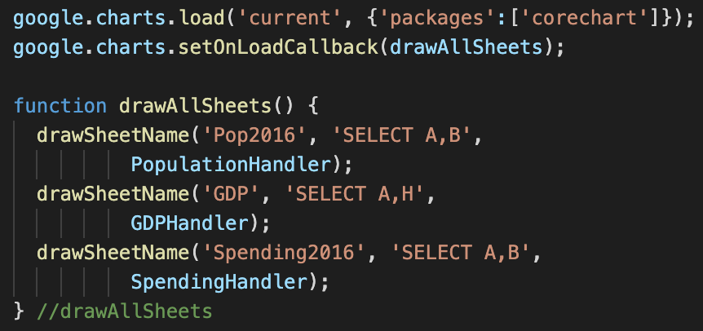
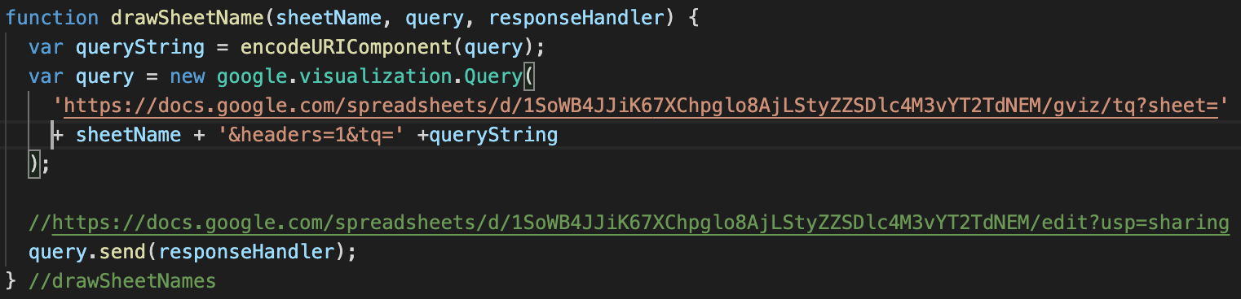
Programming Introduction
Google API
Data Site:
https://docs.google.com/spreadsheets/d/1SoWB4JJiK67XChpglo8AjLStyZZSDlc4M3vYT2TdNEM/edit?usp=sharing
Notes:
I learned how to load data from Google Sheet because I needed to load a lot of tables.

Slide 8
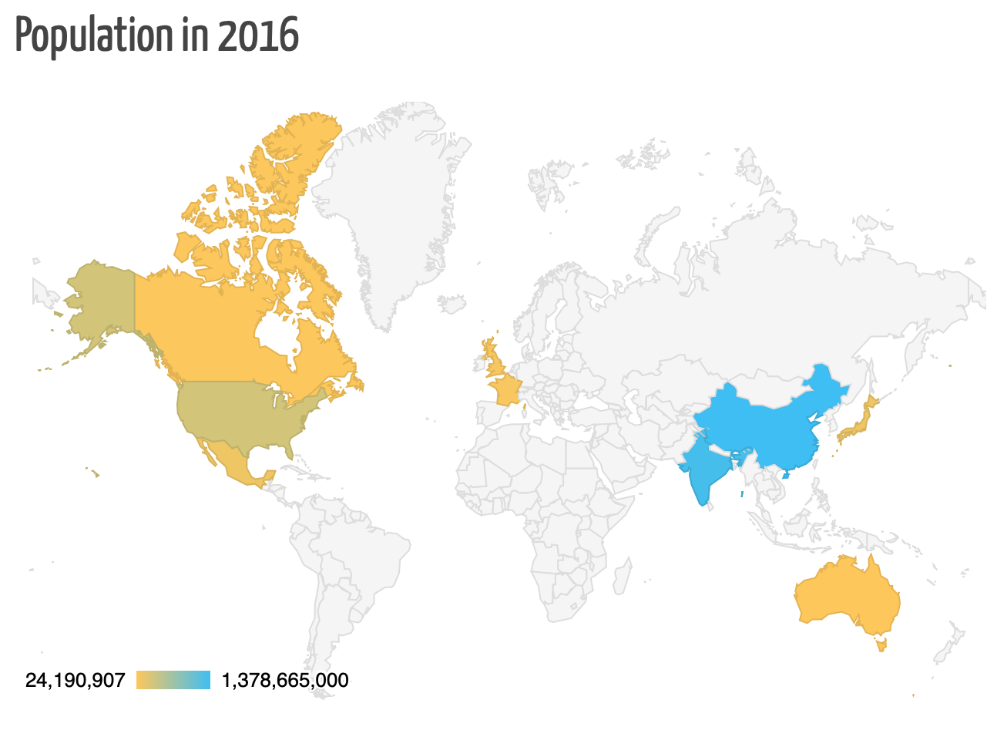
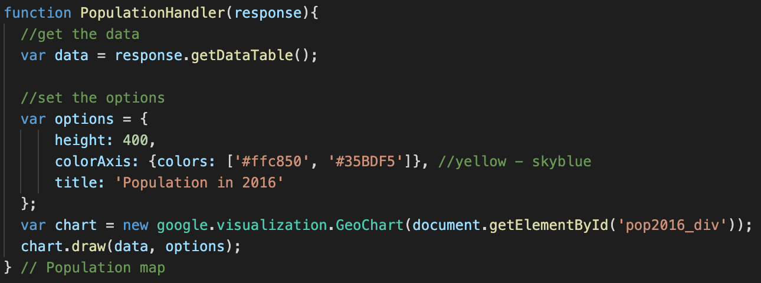
Programming Introduction
Draw charts by define functions
Notes:
And I mastered how to struct different kinds of charts and how to adjust options by following google developer instructions.

Slide 9
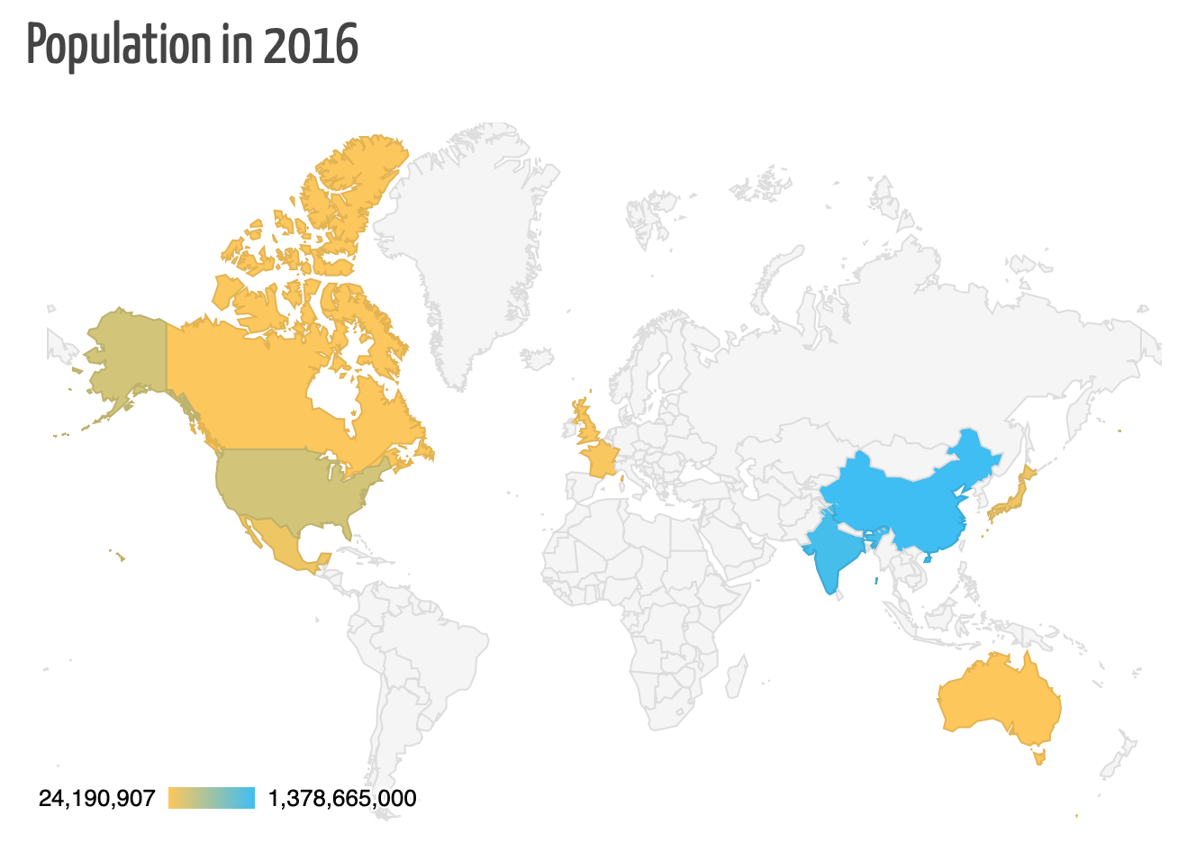
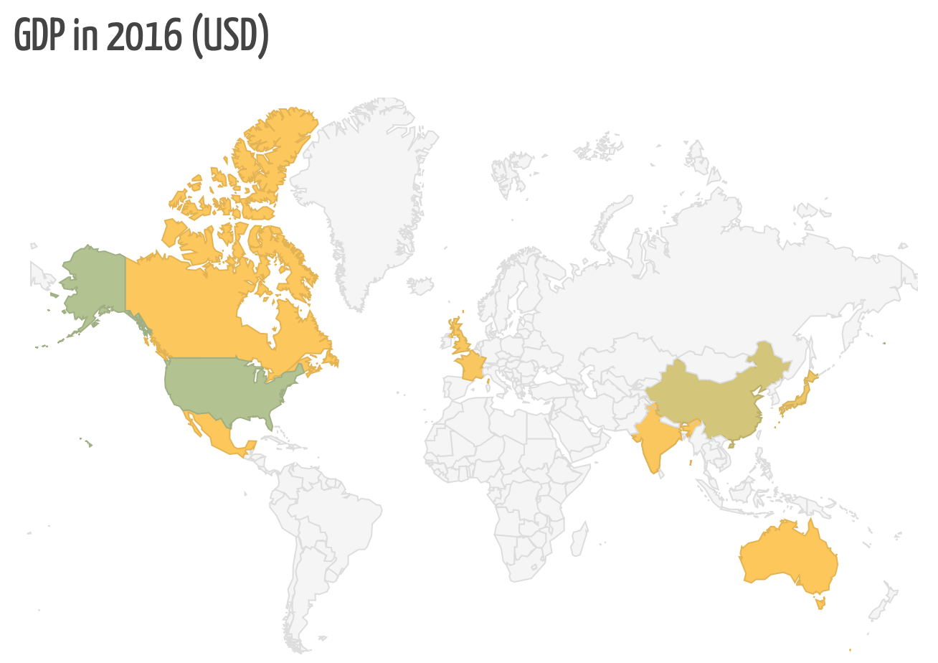
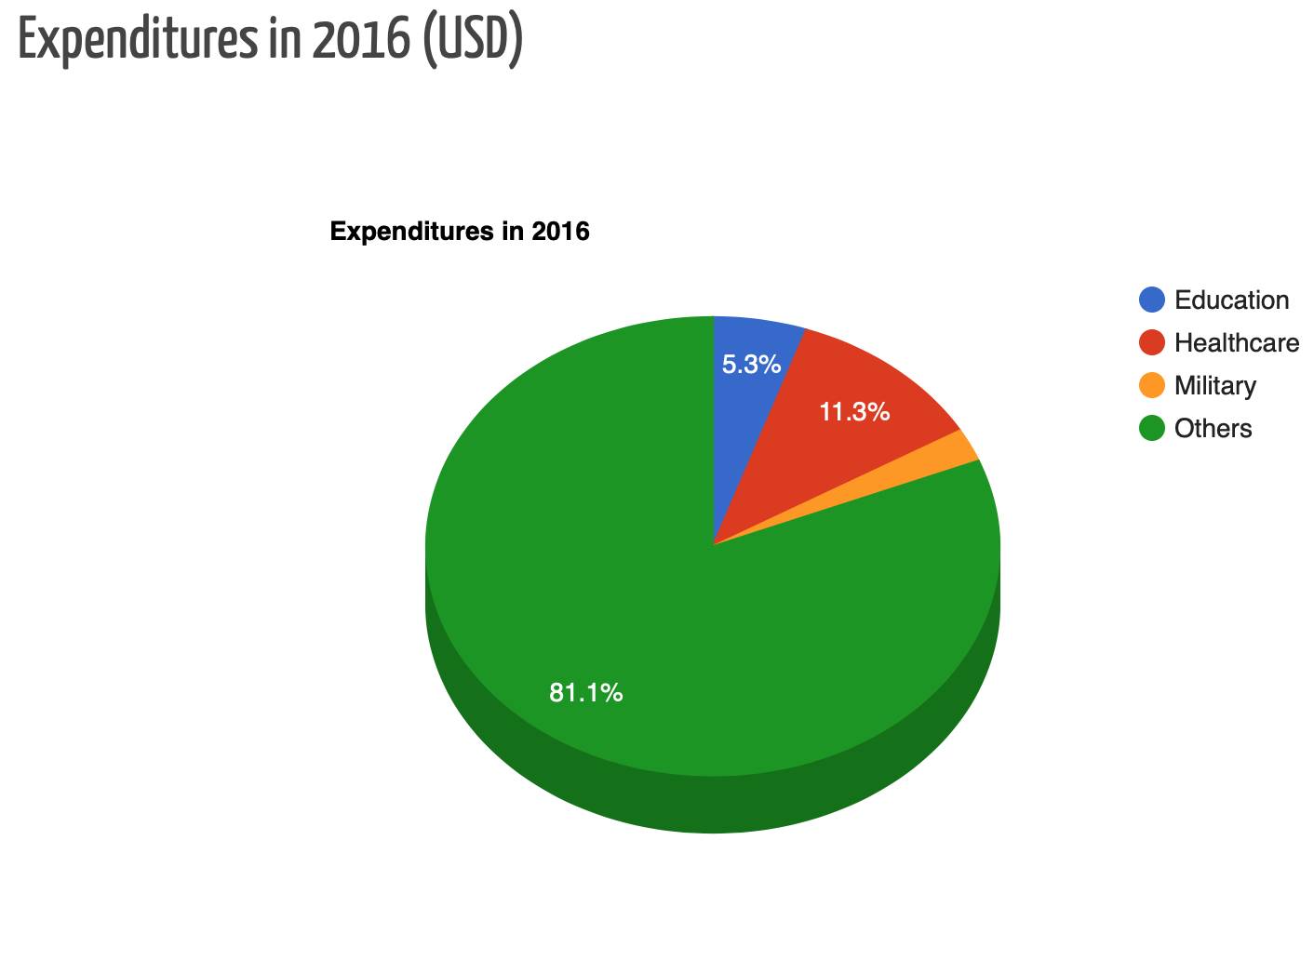
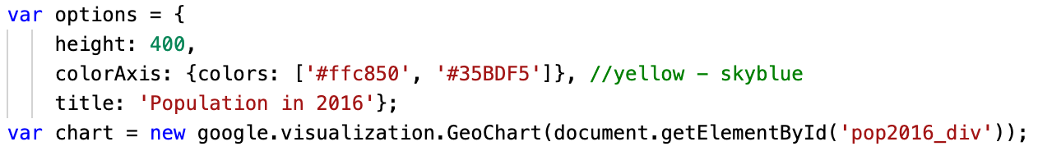
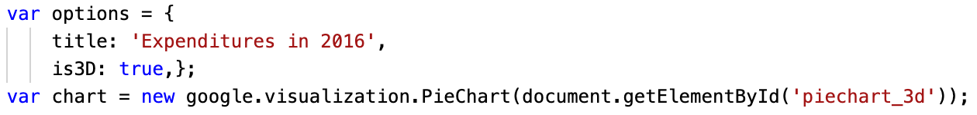
Overview
Geo Chart
Pie Chart
Notes:
According to the Geo Chart, China and India are the most populous countries. But large countries with large populations do not take advantages in the GDP Geo Char.
The pie chart shows that, among other things, healthcare spending dominates. This also shows that the medical level is very important to the national development.

Slide 10
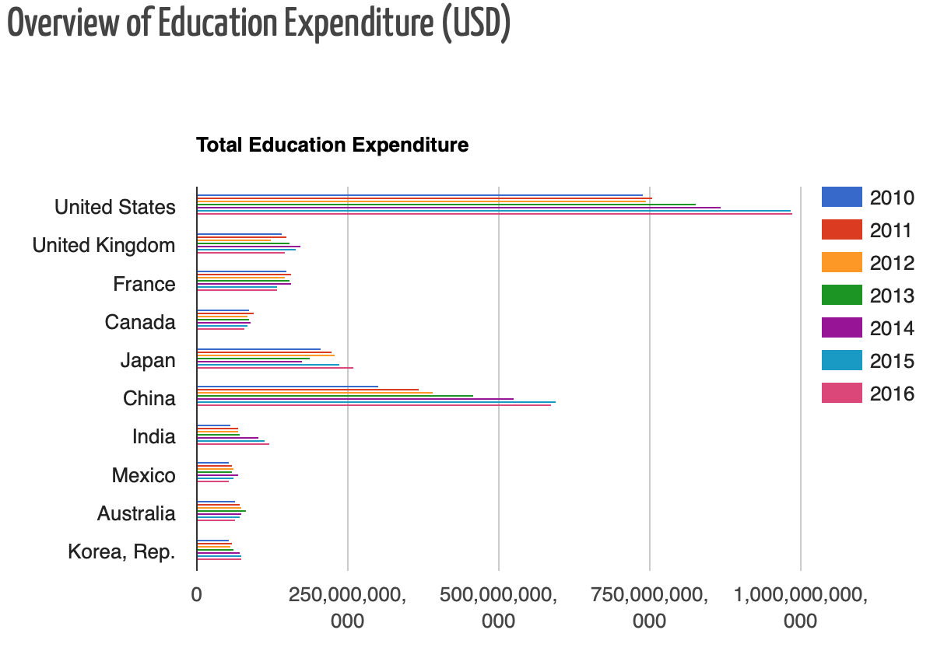
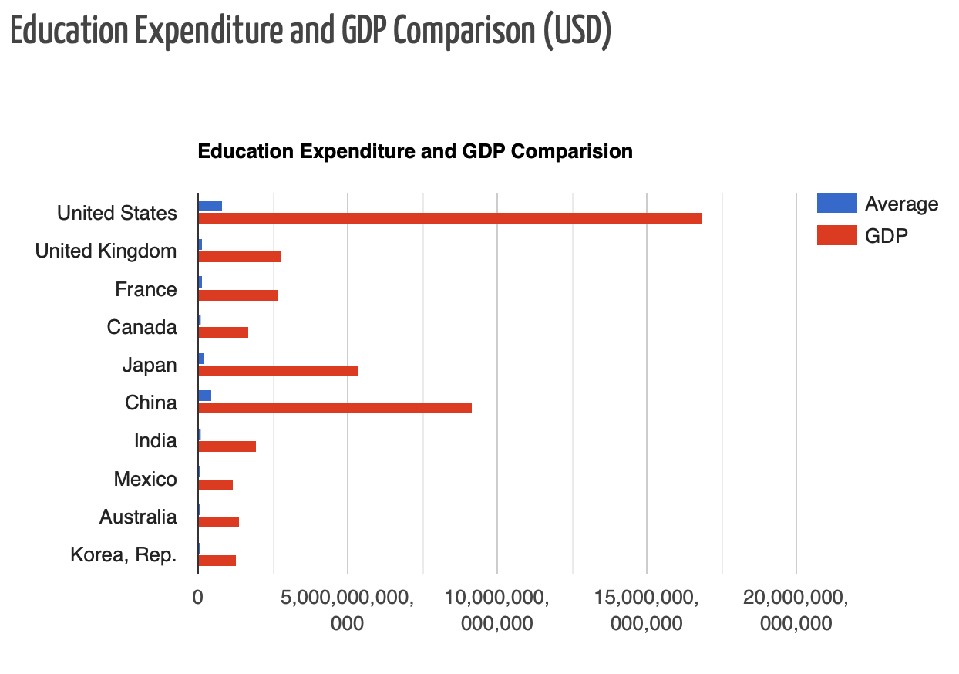
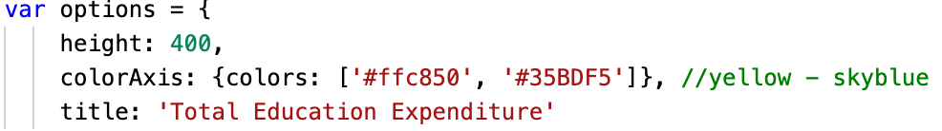
Education
Both the United States and China rank among the top. This is closely related to the relatively developed GDP of these two countries.
Bar Chart

Slide 11
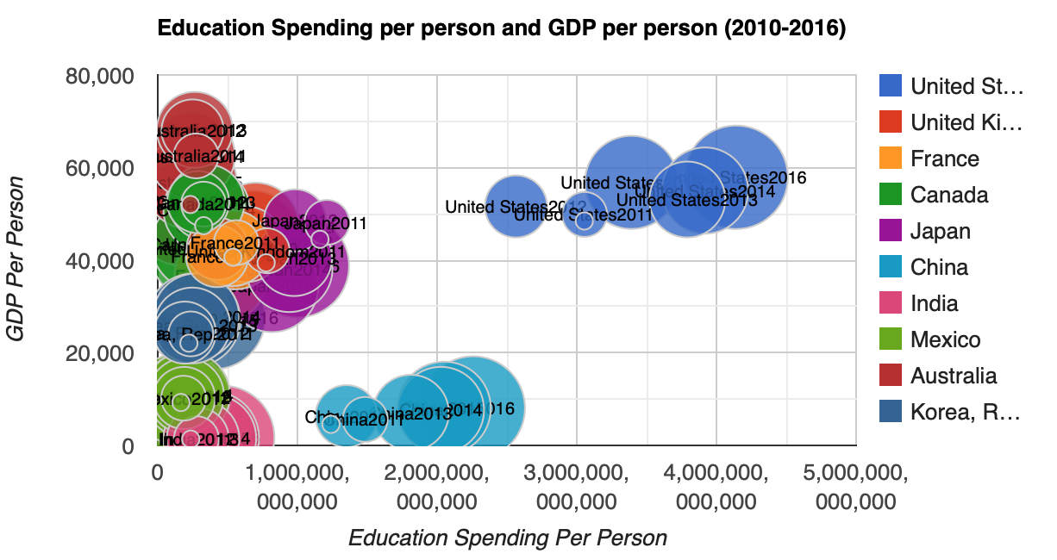
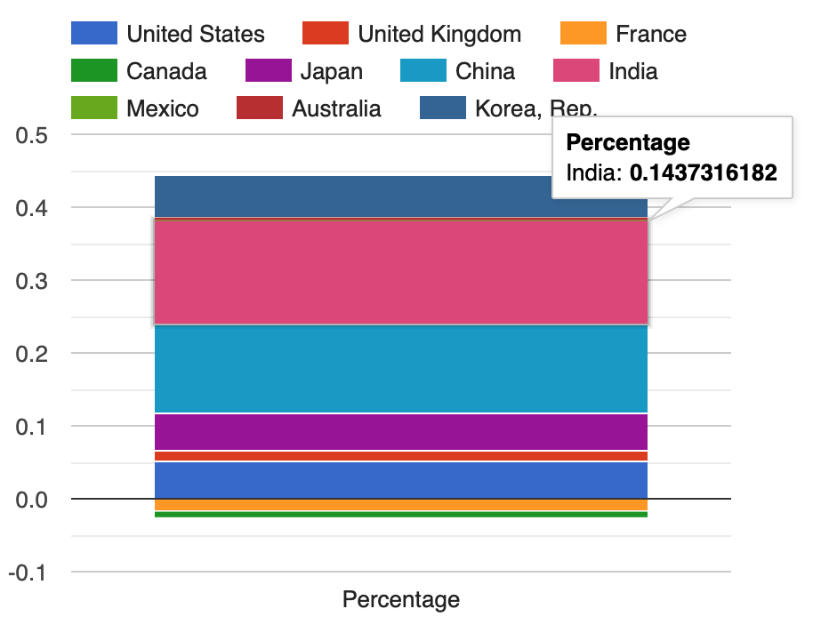
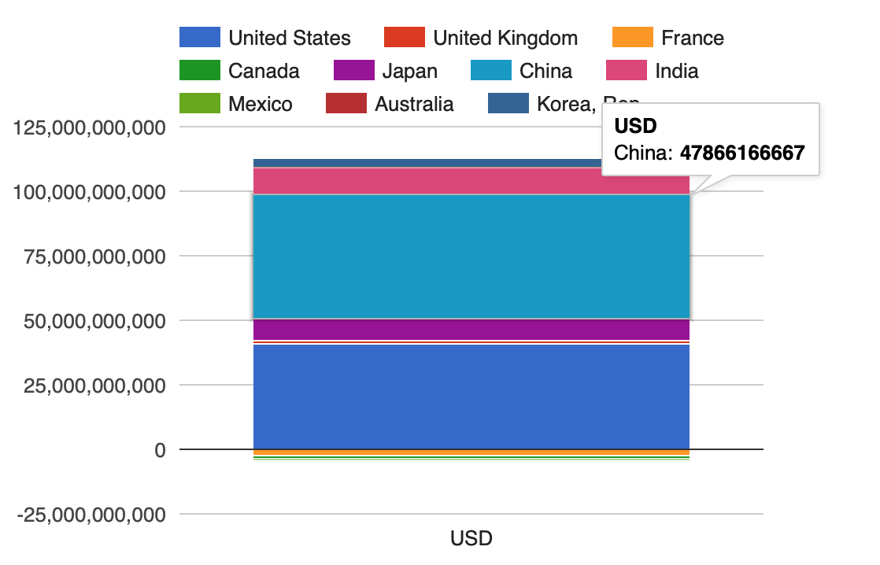

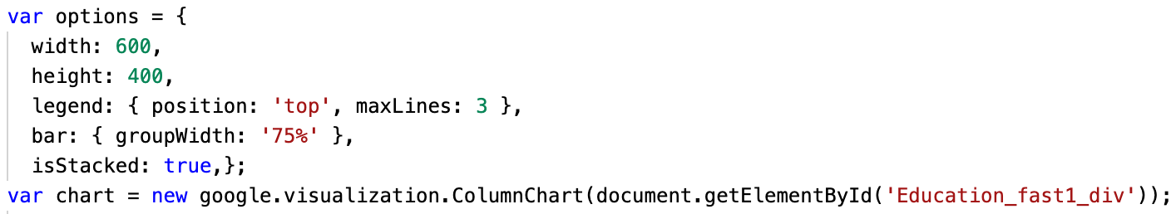
Education
How much an individual values education?
Bubble Chart
Column Chart
Notes:
In the bubble chart, we can see how much each individual citizen values education.
China, for example, has a low GDP per capita but high spending on education.
The growth rate of education expenditure in recent years also shows the importance of the education in China.

Slide 12
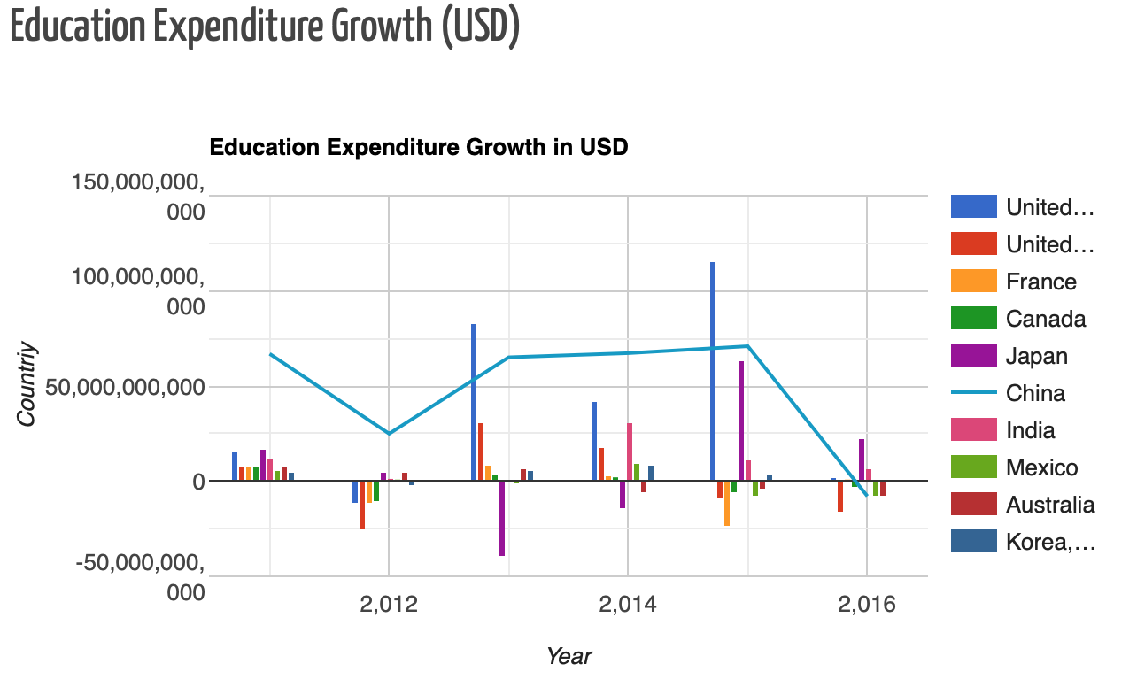
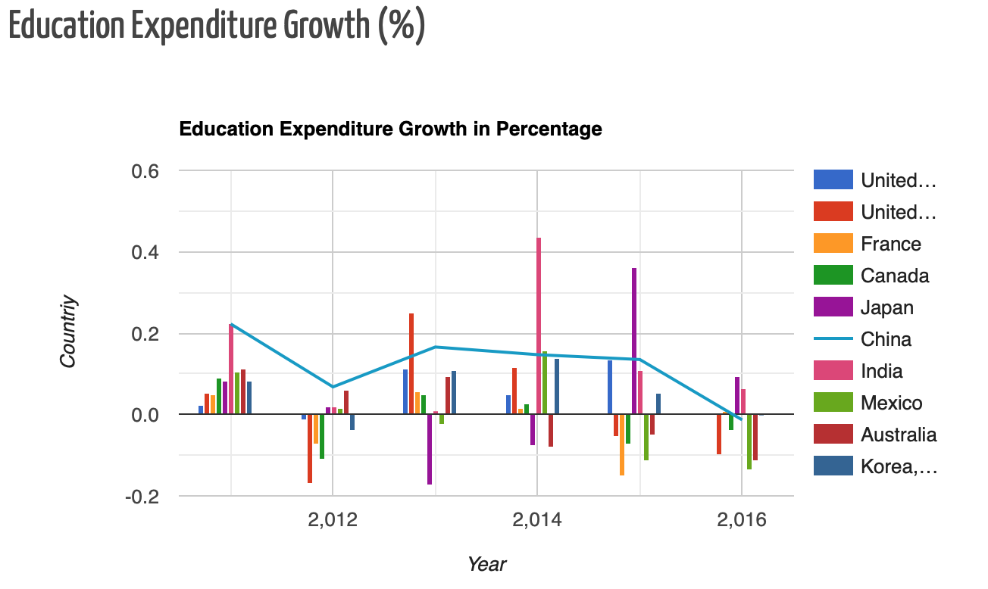
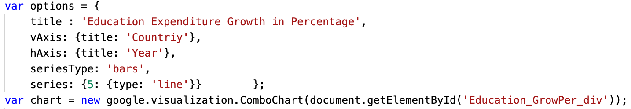
Education
Forecast
Combo Chart
Notes:
In both combo charts, it is easier to see the trend of the growth rate on the chart and to compare it with other countries. Take China as an example. From 2010 to 2016, we can predict a downward trend in China's education spending over the next few years.

Slide 13
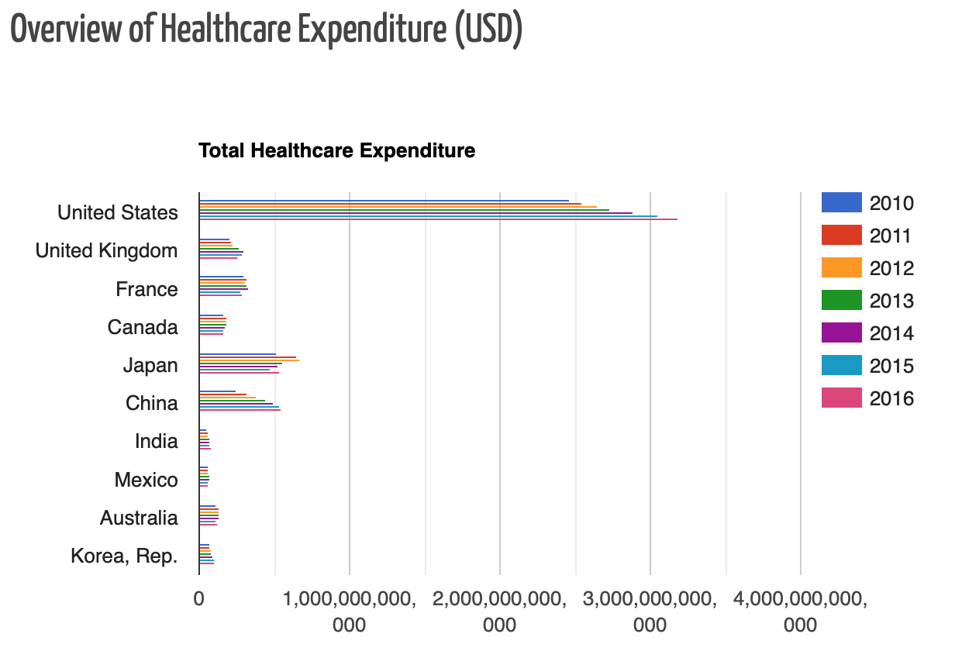
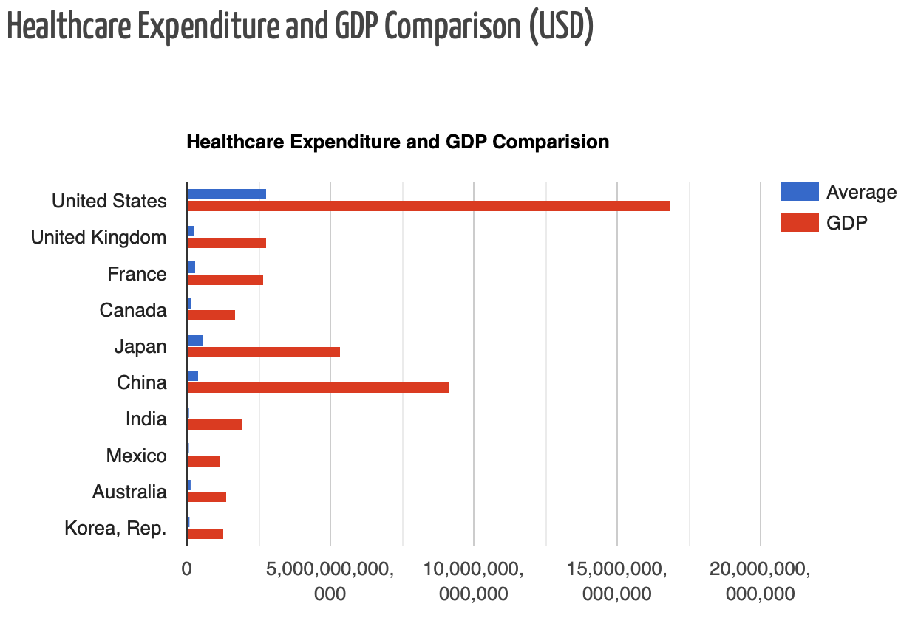
Healthcare
Bar Chart
Notes:
America spends far more on health care than any other country. India and Mexico ranked last. But clearly the basis of the country's GDP is relevant. So we need to look at the relationship between individual GDP and individual health care spending.

Slide 14
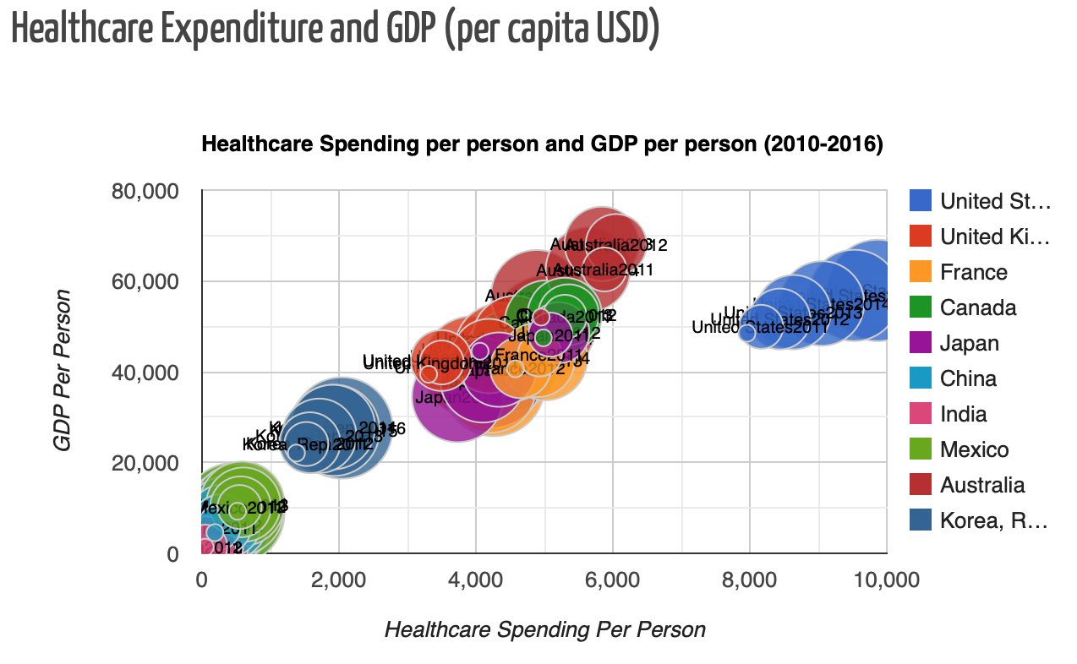
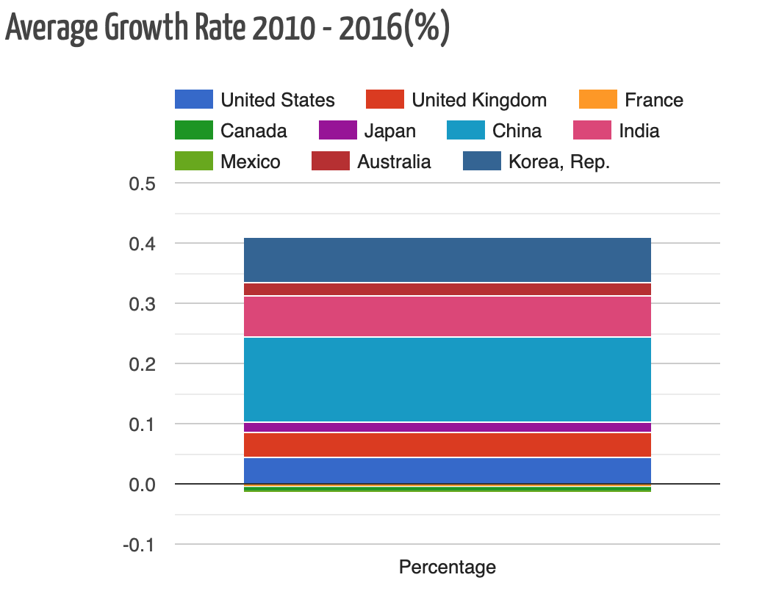
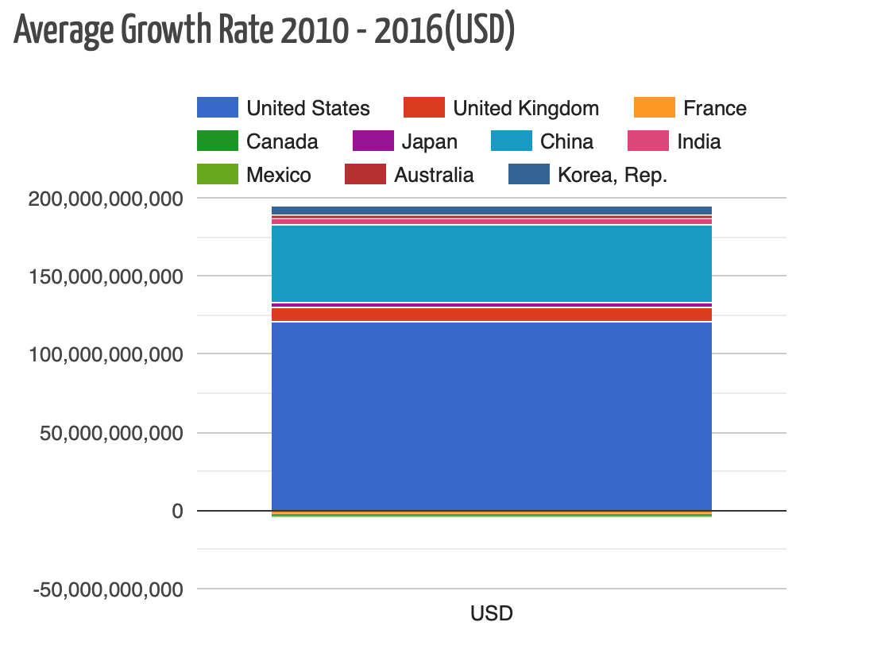
Healthcare
How much an individual values healthcare?
Bubble Chart
Column Chart
Notes:
As can be seen from the bubble chart, there is a significant positive correlation between personal GDP and personal health care expenditure. So I guess the growth of health care and the growth of GDP firmly related.

Slide 15
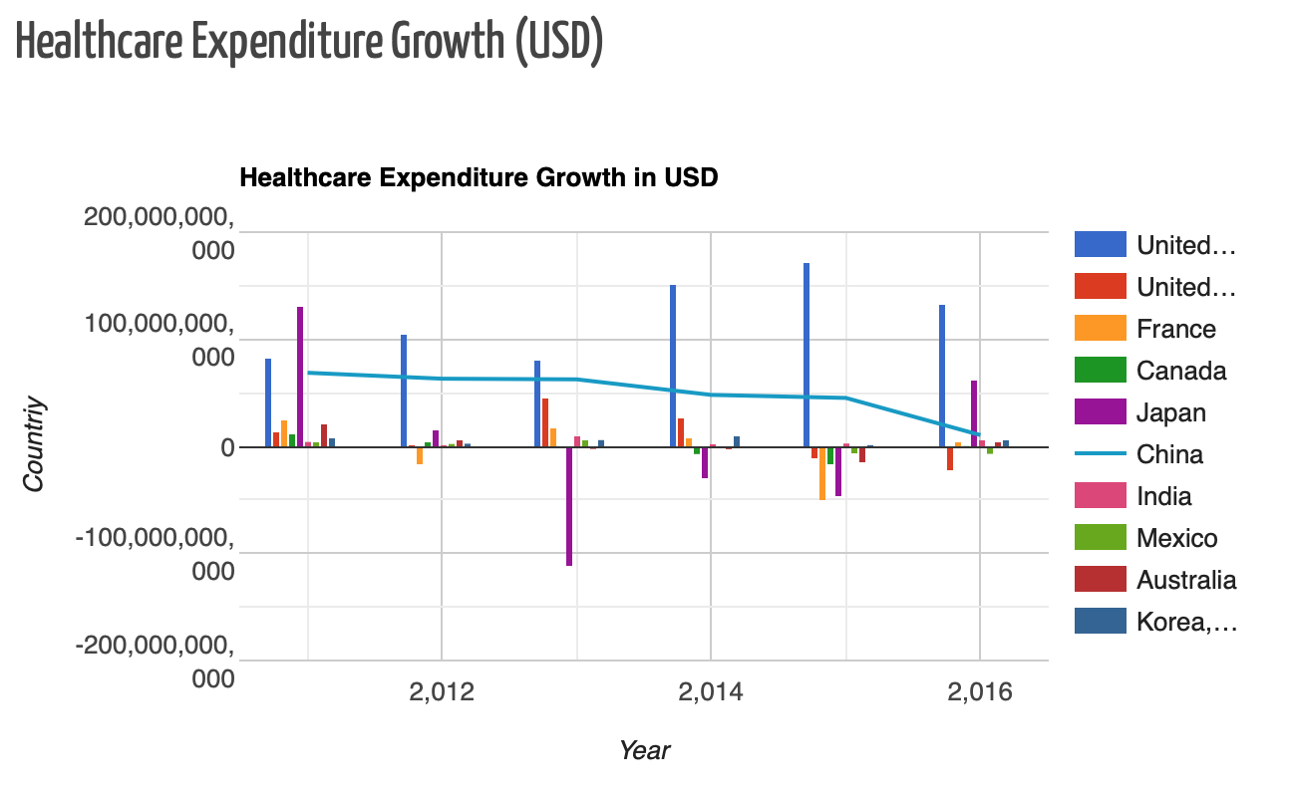
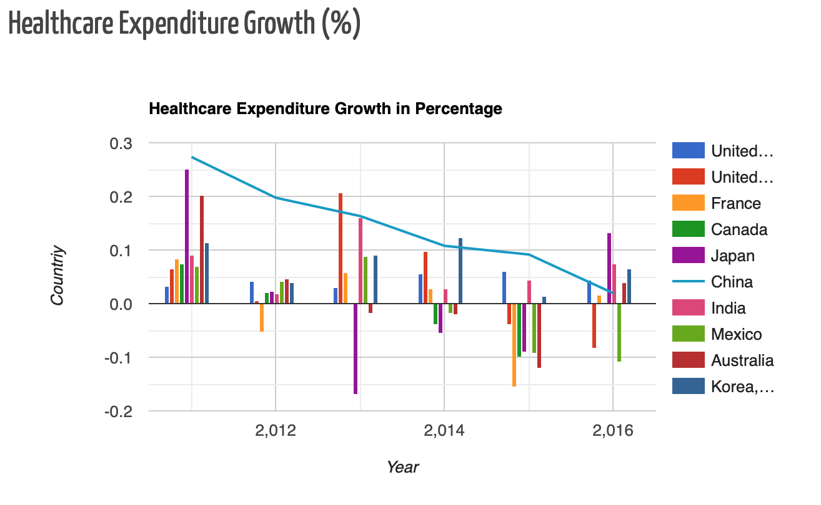
Healthcare
Forecast
Combo Chart
Notes:
I also take China as an example for prediction. You can see it’ healthcare expenditure should continue to decline or even negatively develop in the next few years.

Slide 16
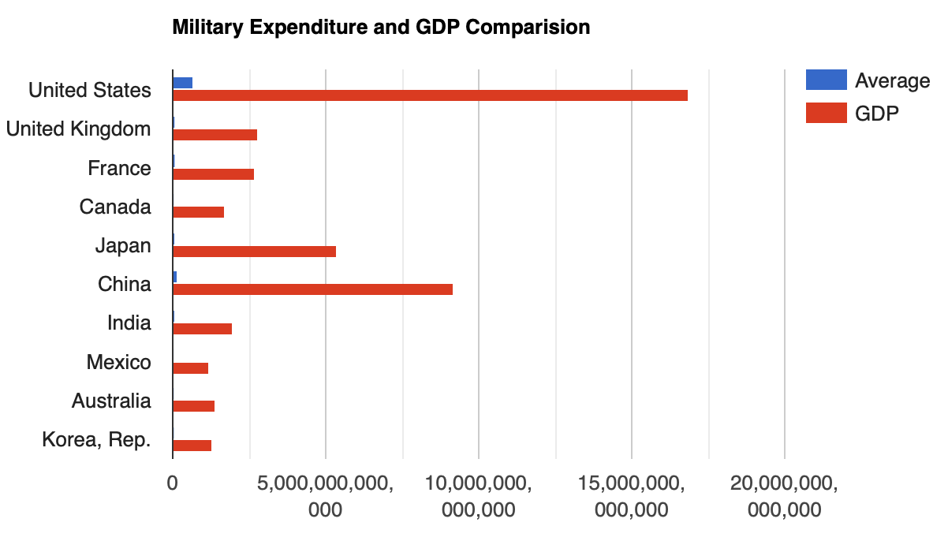
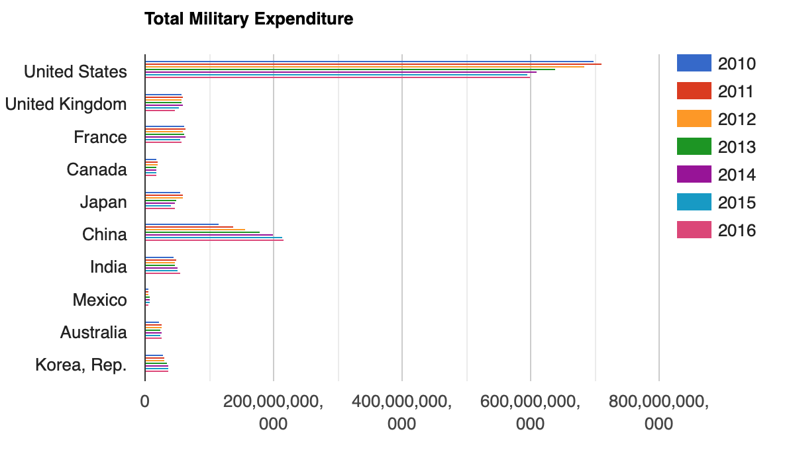
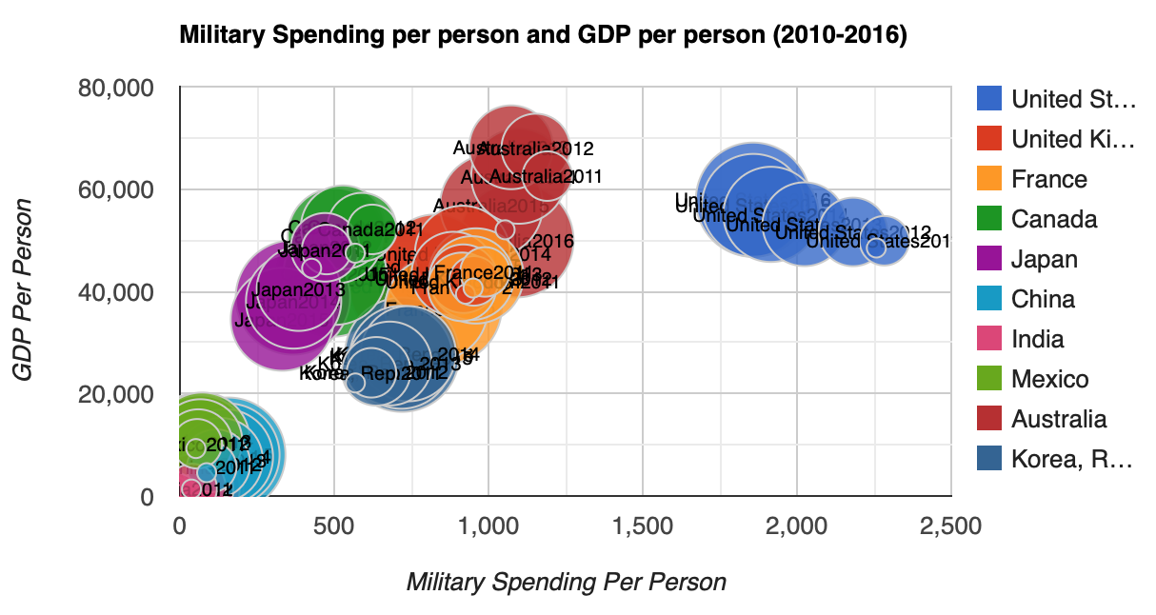
Military
In military part, we can also see the strong relations between expenditure and GDP. Therefore, I tried to study more about GDP impact.

Slide 17
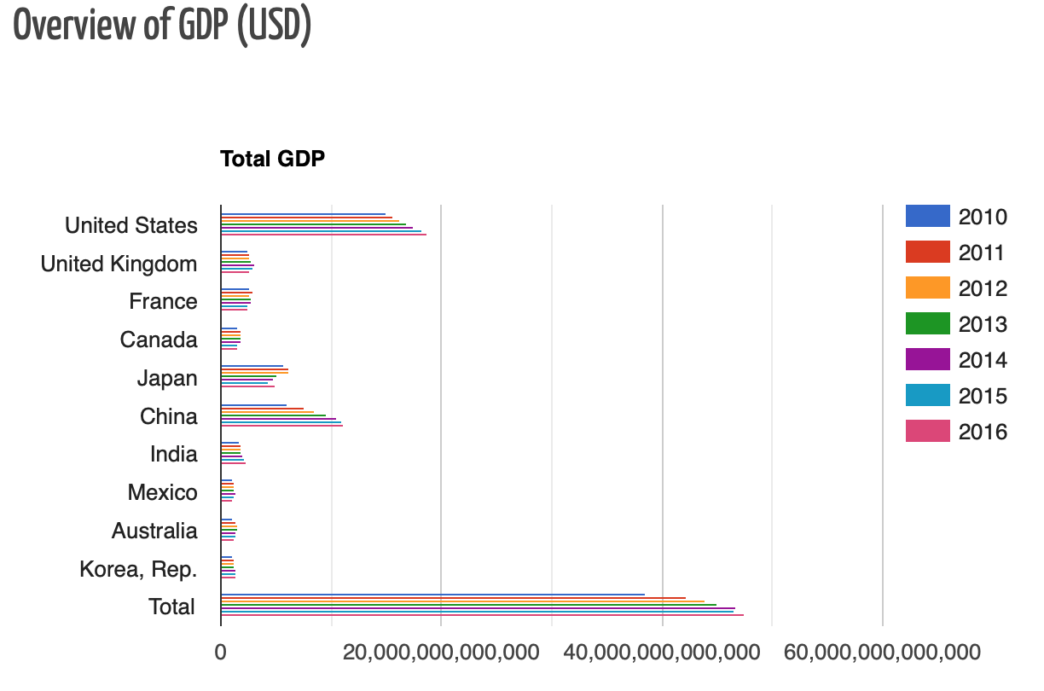
GDP Impact
This bar chart demonstrates that the United States and China rank high in the world in terms of overall GDP.
According to the total value, world GDP is growing year by year.

Slide 18
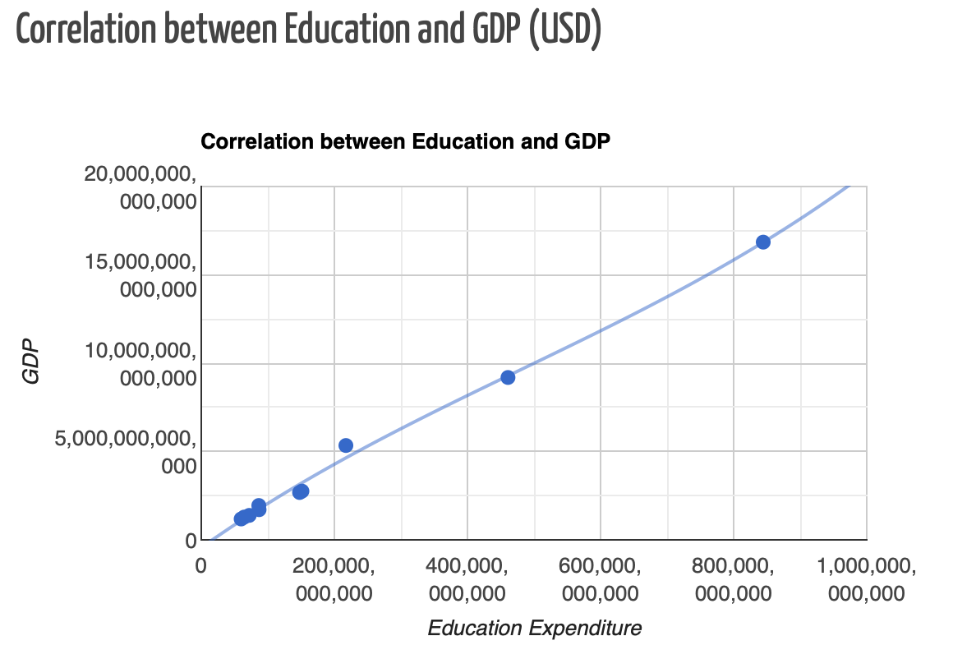
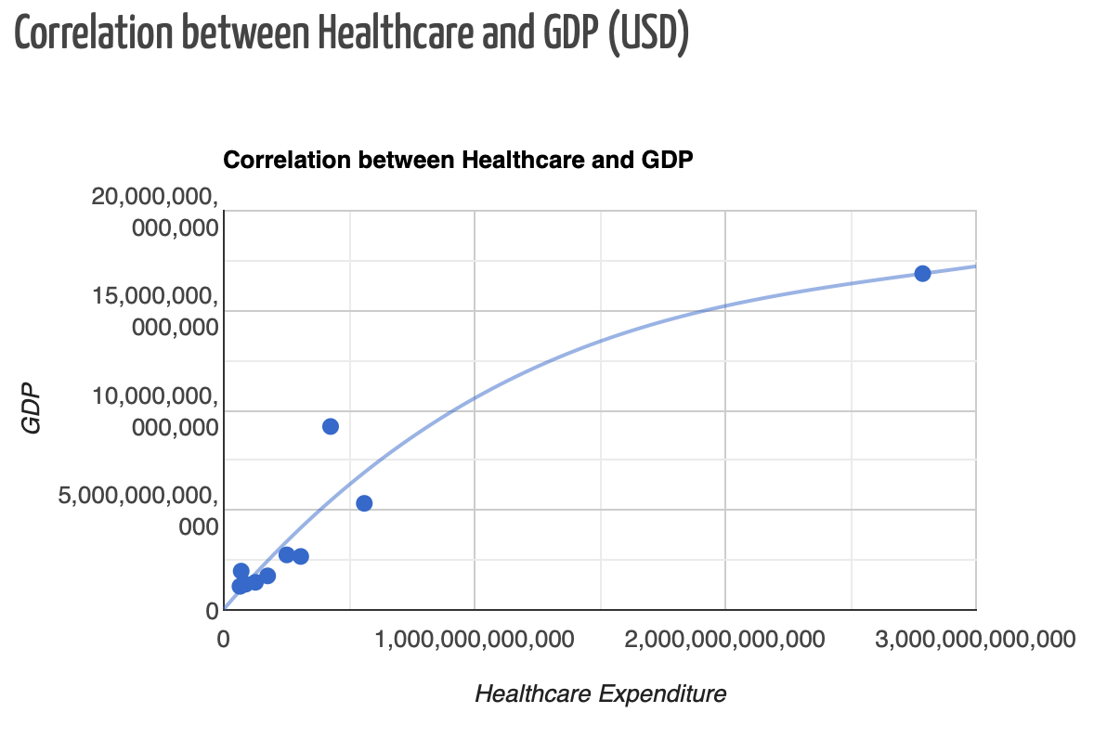
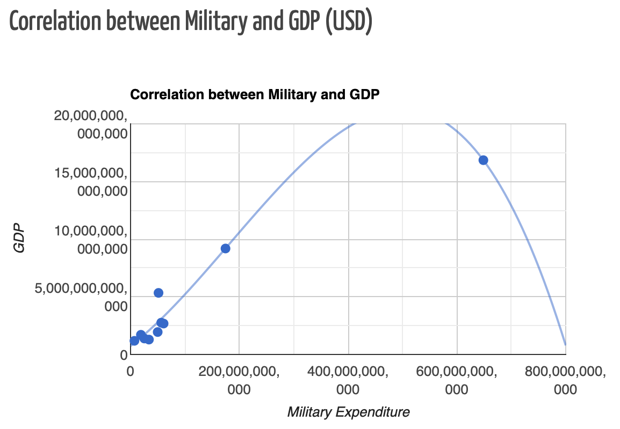
GDP Impact
As can be seen from the bar chart, the overall GDP increased year by year from 2010 to 2016. The US has the largest share of GDP, while Mexico and South Korea have the fewest.
We can see from the graphs of scatter and trendline that spending on education and health care is proportional to GDP. Military spending, on the other hand, begins to move inversely to GDP at a certain point.

Slide 19
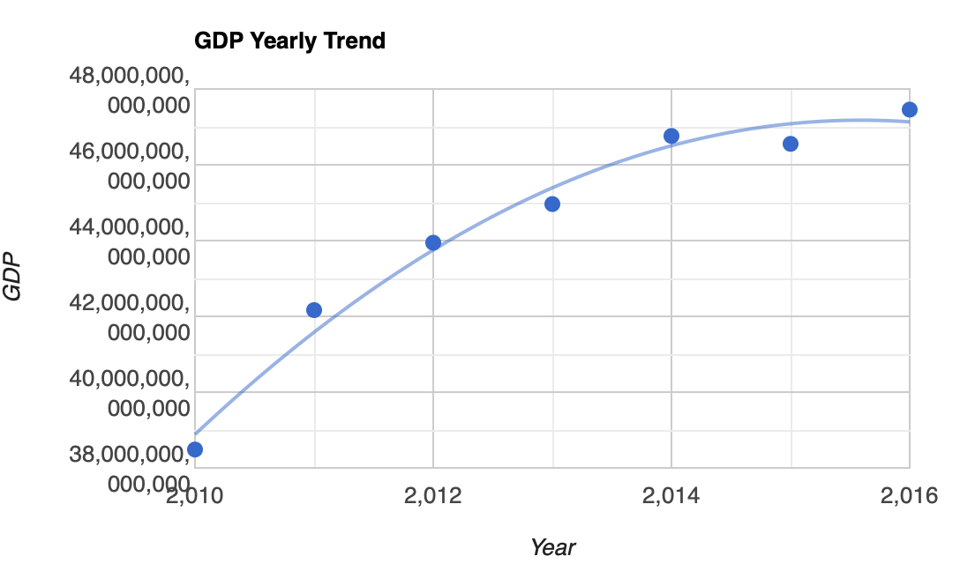
GDP Impact - Forecast
The trend of GDP growth is slow year by year. Based on the relationship between education, healthcare expenditure and GDP, I predict that education and healthcare expenditure will also decline in the future.
The current peak of GDP has not yet reached the turning point of military, so I believe that military spending will also decline with GDP.

Slide 20
Conclusion
The expenditure of Healthcare takes the largest part of all the three categories.
All three expenditures have a high correlation with GDP, and the correlation between education and GDP is the highest.
The United States is always the top spenders because of its absolute advantage in GDP.
China has seen the biggest growth in expenditure and GDP in recent years.
China's individual spending on education is outstanding, which is probably the main reason for its fast GDP growth. The relationship between education and GDP bears this out.
World GDP will slow down in the future.

Slide 21
References
World Bank Group: worldbank.org
Google Charts: developers.google.com/chart
Medium: medium.com
Flaticon: flaticon.com
Google Developer: developers.google.com
W3School: w3schools.com/

Slide 22
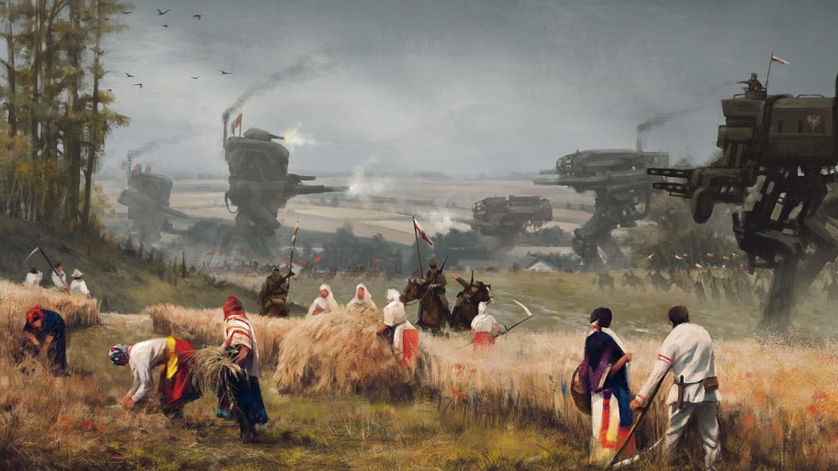
Thanks for watching

Slide 23
Publish Links

